Slide 1
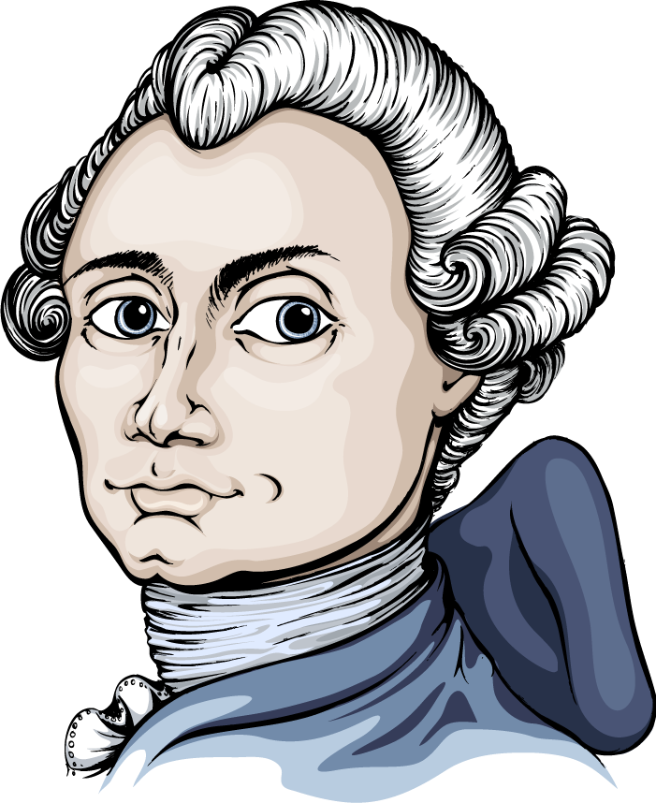
Messier Bingo

Slide 2
Charles Messier
Lived from 1730 to 1817 in Paris
Wanted to discover comets

Slide 3
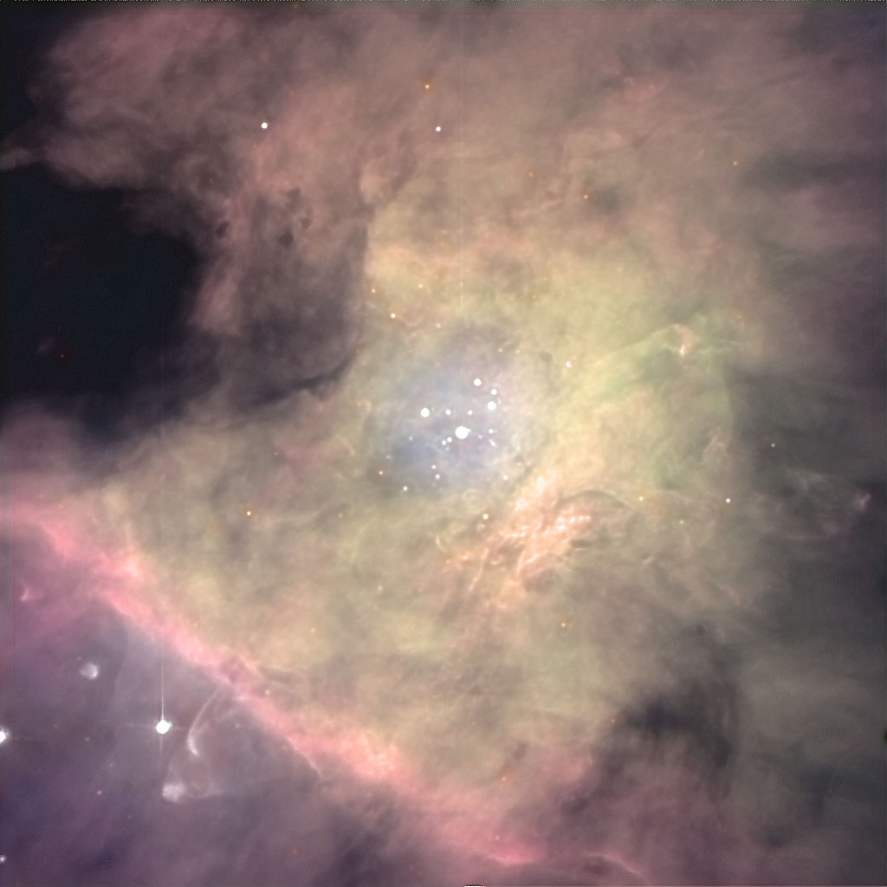
Nebula
M42

Slide 4
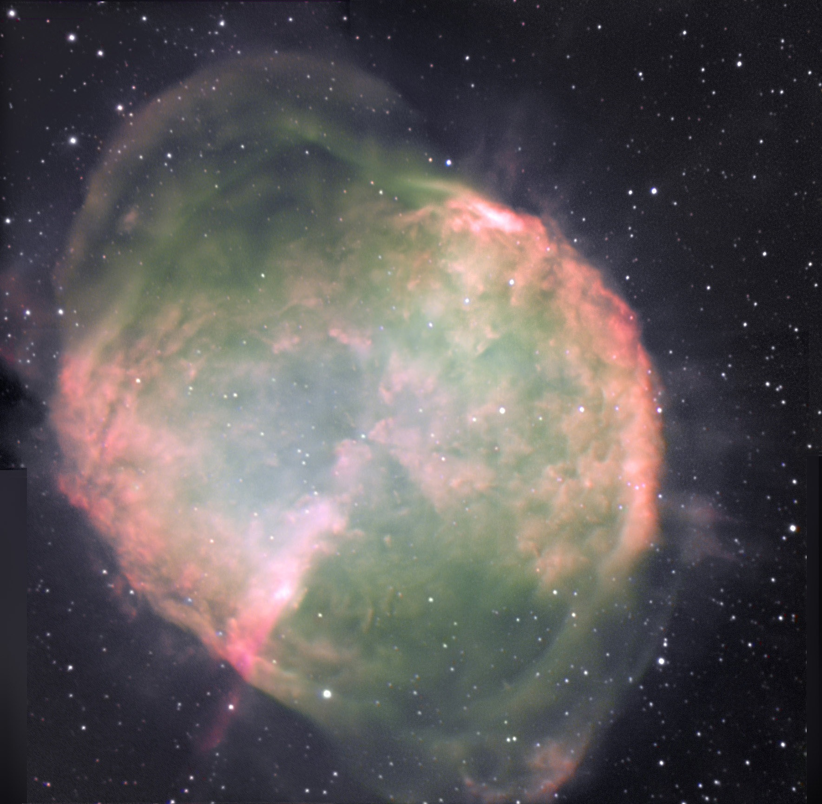
Planetary
Nebula
M27

Slide 5
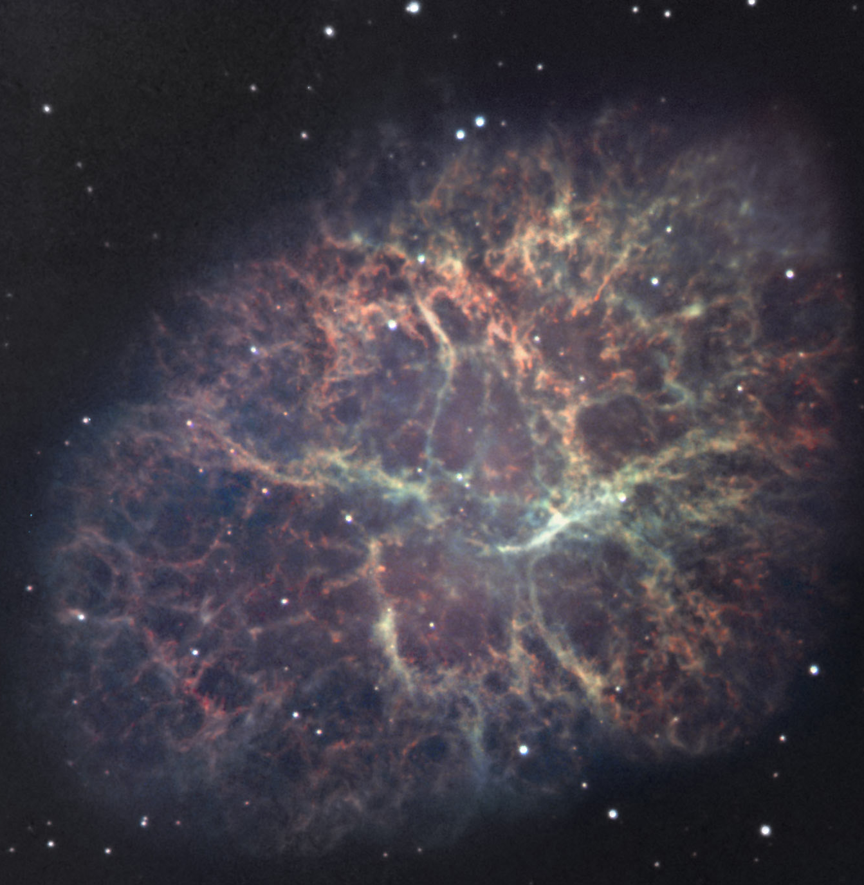
Supernova Remnant
M1

Slide 6
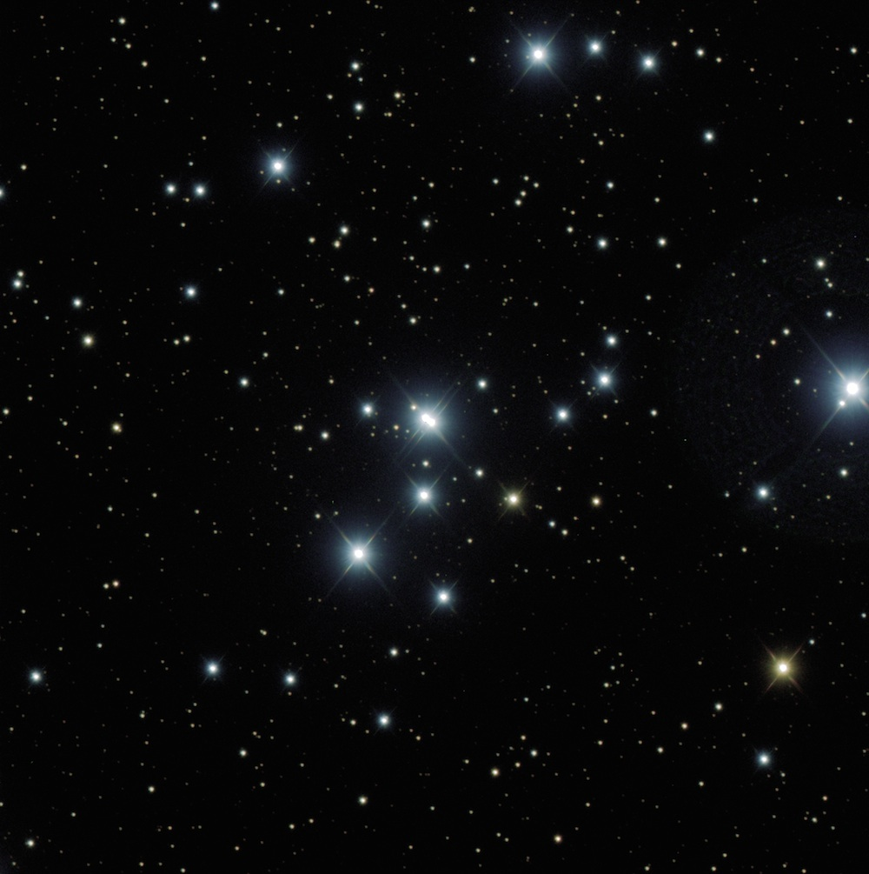
Open
Cluster
M47

Slide 7
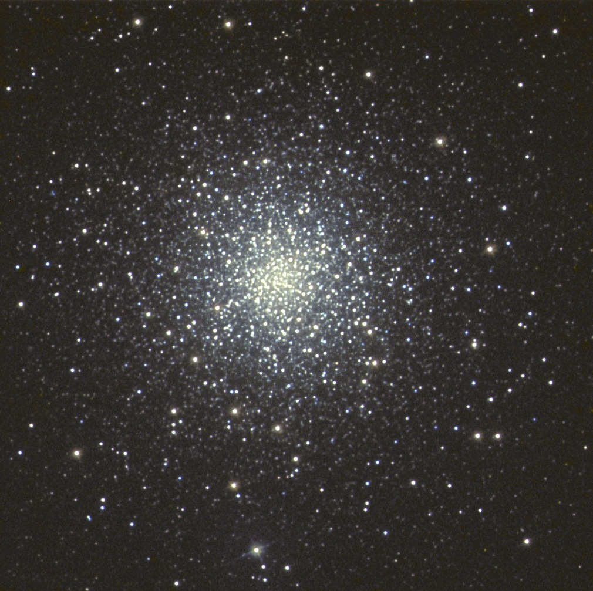
Globular
Cluster
M79

Slide 8
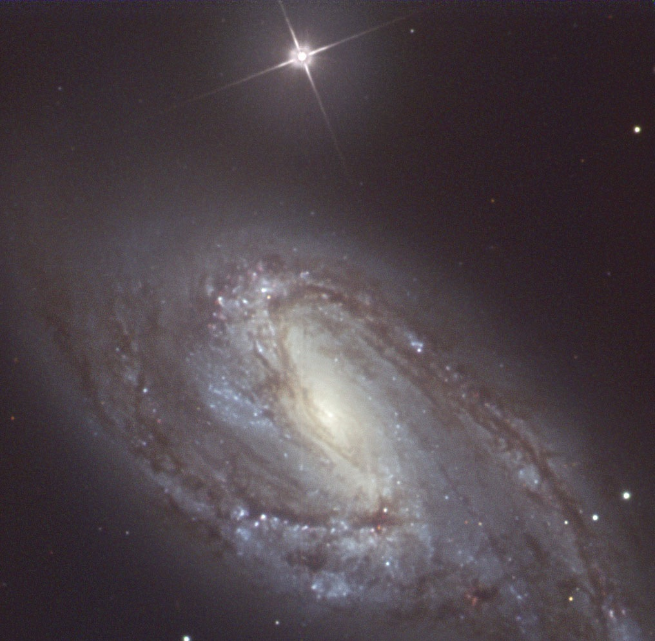
Spiral
Galaxy
M66

Slide 9
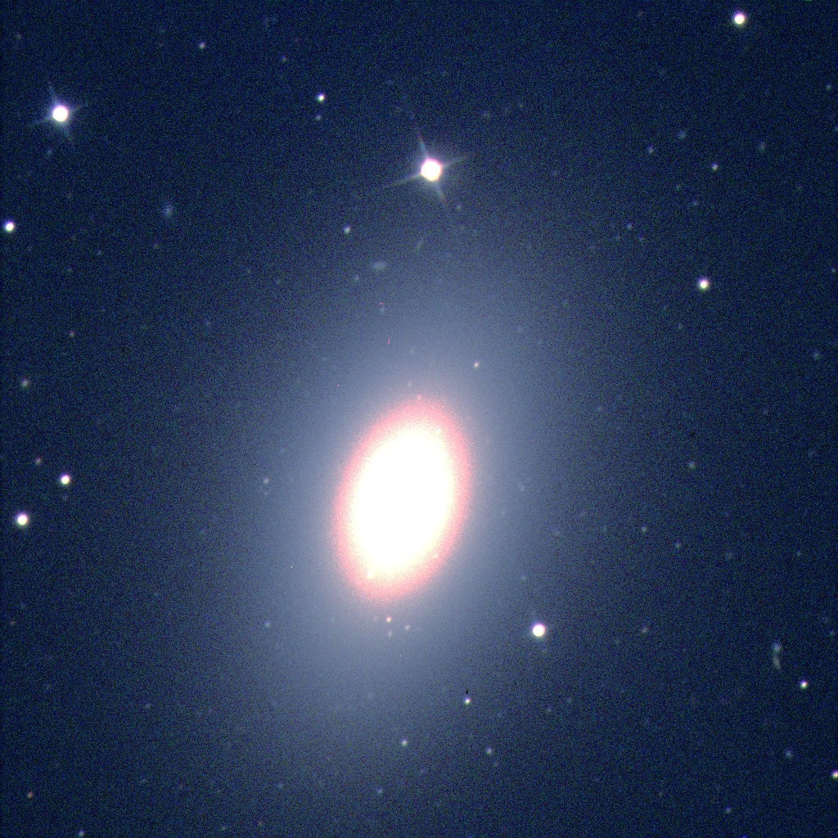
Elliptical
Galaxy
M60

