Slide 1
Serol in the Classroom
Part 3

Slide 2
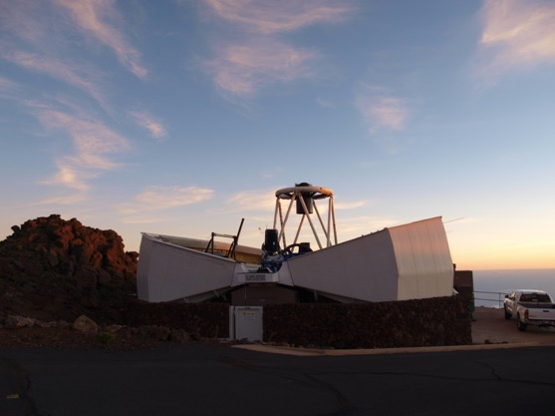
ROBOT

Slide 5
SEROL says

Slide 7
What do we do with the telescopes?
Study asteroids
Study exploding stars
take amazing pics!

Slide 10
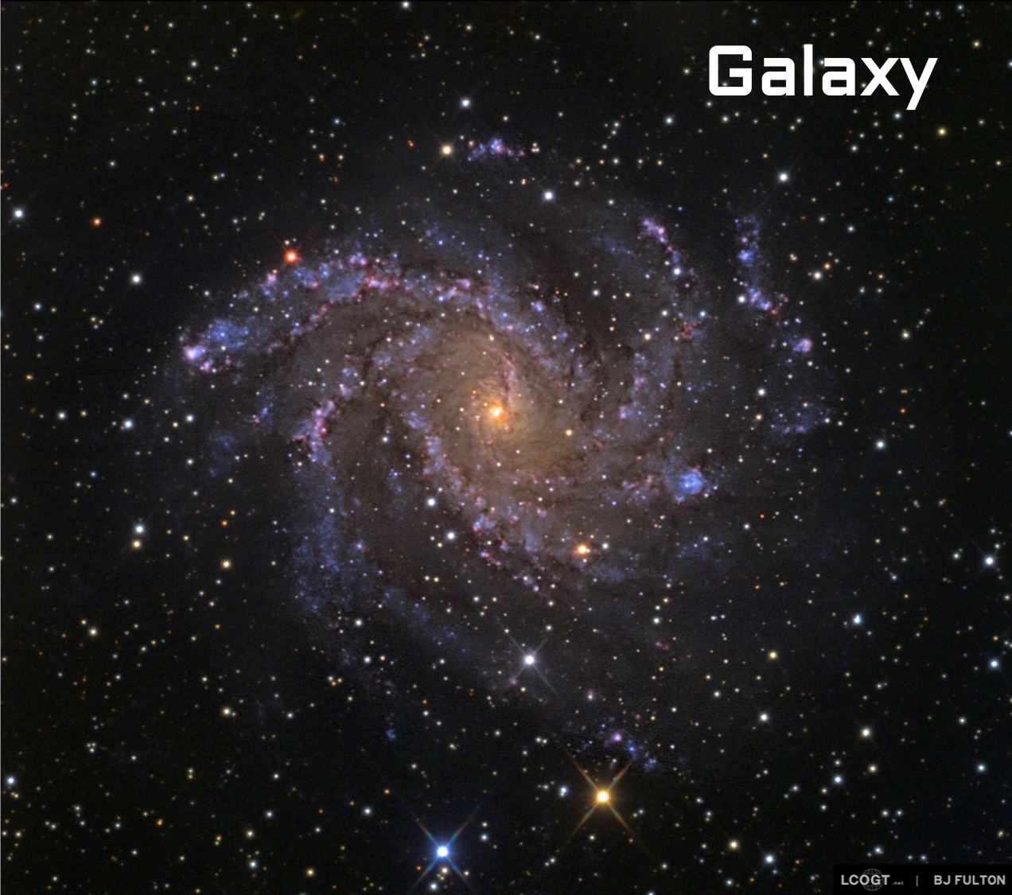

Slide 11
Messier Bingo
https://messierbingo.lco.global

