Slide 1
Gemini Observatory Archive and Data Reduction
Bryan Miller
Paul Hirst, Ricardo Cardenes, Joanna Thomas-Osip
Gemini Observatory

Slide 2
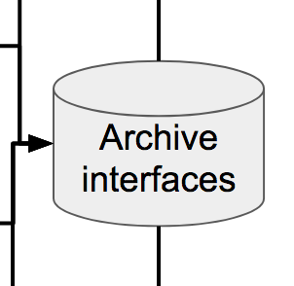
Introduction
We currently close the loop with program teams by:
serving data via the Gemini Observatory Archive (GOA)
providing tools for science quality reduction

Slide 3
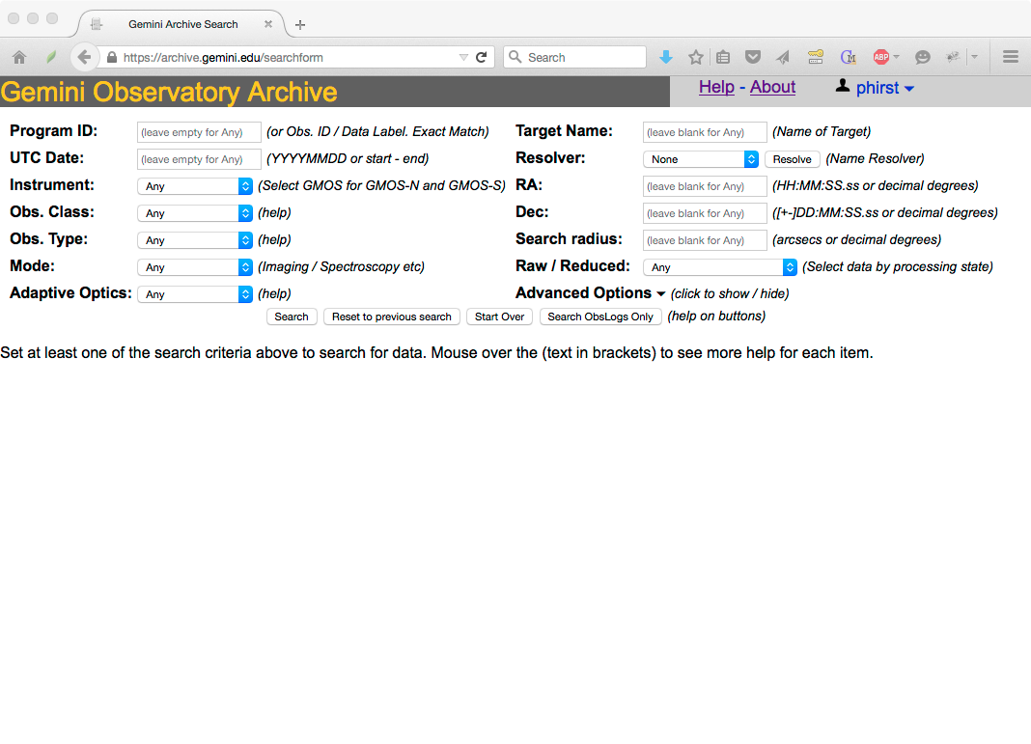
Current version operational in late 2015 after ~15 years of being hosted by CADC
Developed and maintained by Gemini
https://archive.gemini.edu
https://www.gemini.edu/node/12440

Slide 4
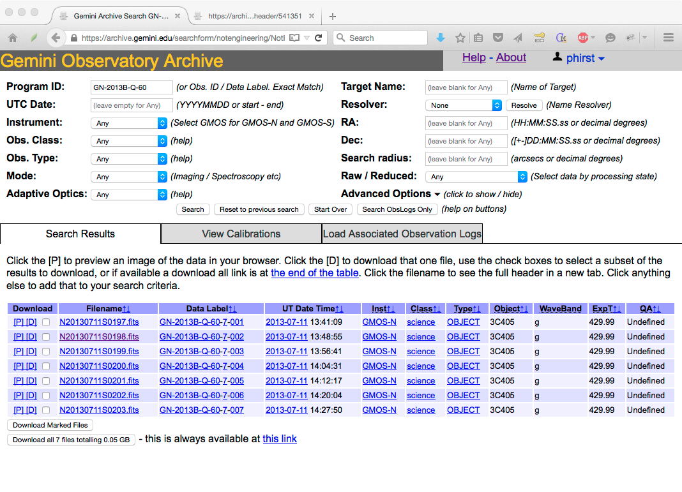

Slide 5
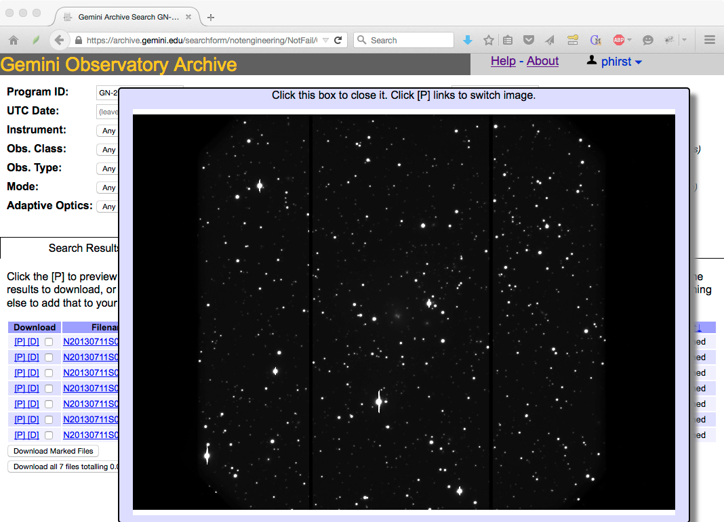

Slide 6
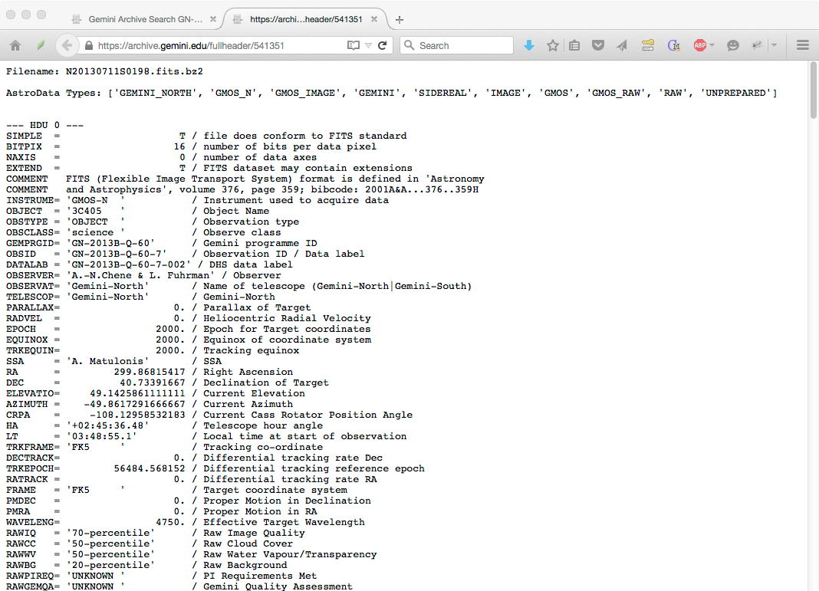

Slide 7
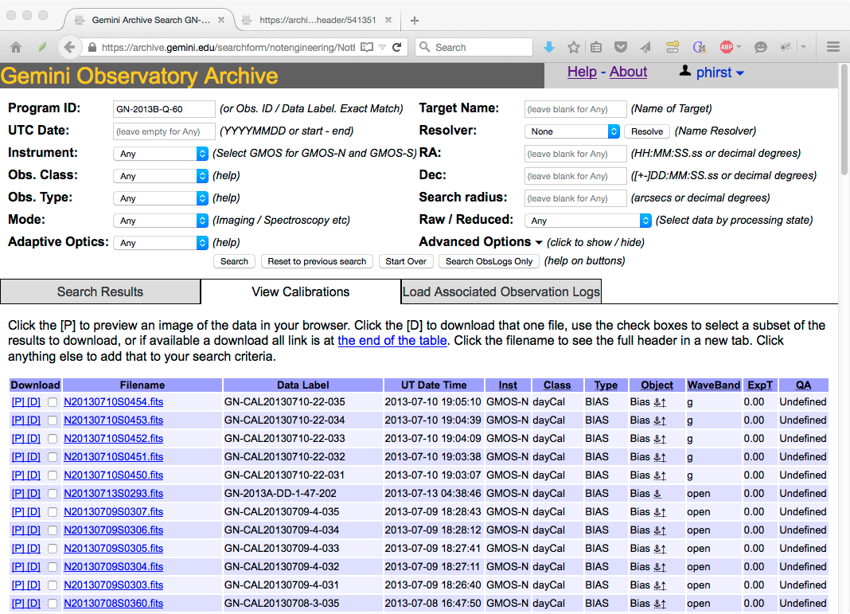

Slide 8
Calibration Association Rules
Automatically find the best calibrations of all relevant types for a given set of data files. The rules are built-in.
Simple ones - “must be the same filter”, “must be within 8 hours”
But also - “must be the same slit, unless its the 5 arc-second slit, in which case any long slit will do”
And - “Instrument gravity vectors must be within X degrees if we are at elevation lower than Y degrees, where X and Y depend on the grating and type of focal plane mask in use”
Usually ranked by closest-in-time. Some by airmass, or sky position. Or some combination of all the above.

Slide 9
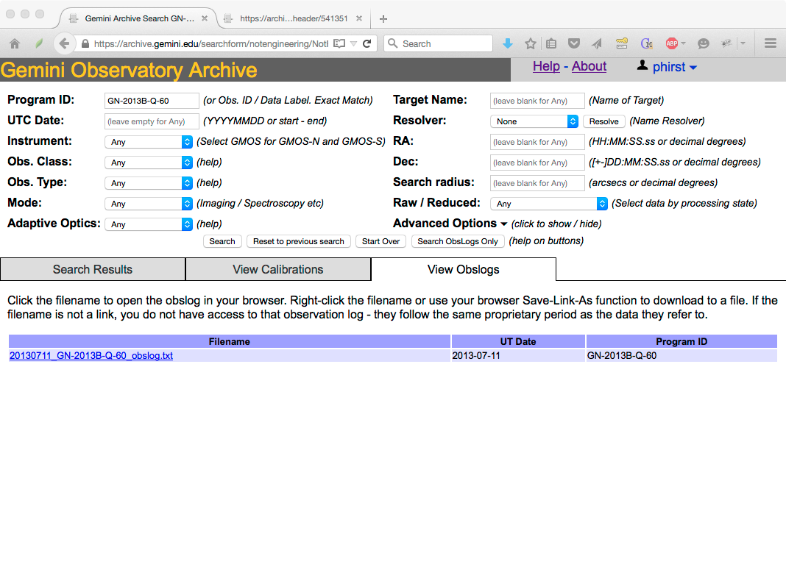

Slide 10
Deployment
Local installations on each summit ingest files from filesystem during observing -> passed to the public archive system.
Archive server at AWS ingests it into archive database.
Latency from file being written at telescope to being available for user download is from archive is typically 20-60 seconds.

Slide 11
Application Programming Interfaces (APIs)
Easy for a human (or a script) to construct URLs that give useful search results directly
https://archive.gemini.edu/<FEATURE>/<SELECTION>
Feature of the system - eg:
searchform: pre-filled search form (html)
summary: data summary (search results, html)
file: single file download
download: tarball of matching results
jsonfilelist: JSON file list
jsonsummary: JSON search results
calmgr: Calibration Association API (xml)
Data Selection /search criteria:
Instrument name
UT date (or range)
Observation type
Filename
Project or Observation ID
Data Label
combine/them/like/this
https://archive.gemini.edu/searchform/20150123/F2

Slide 12
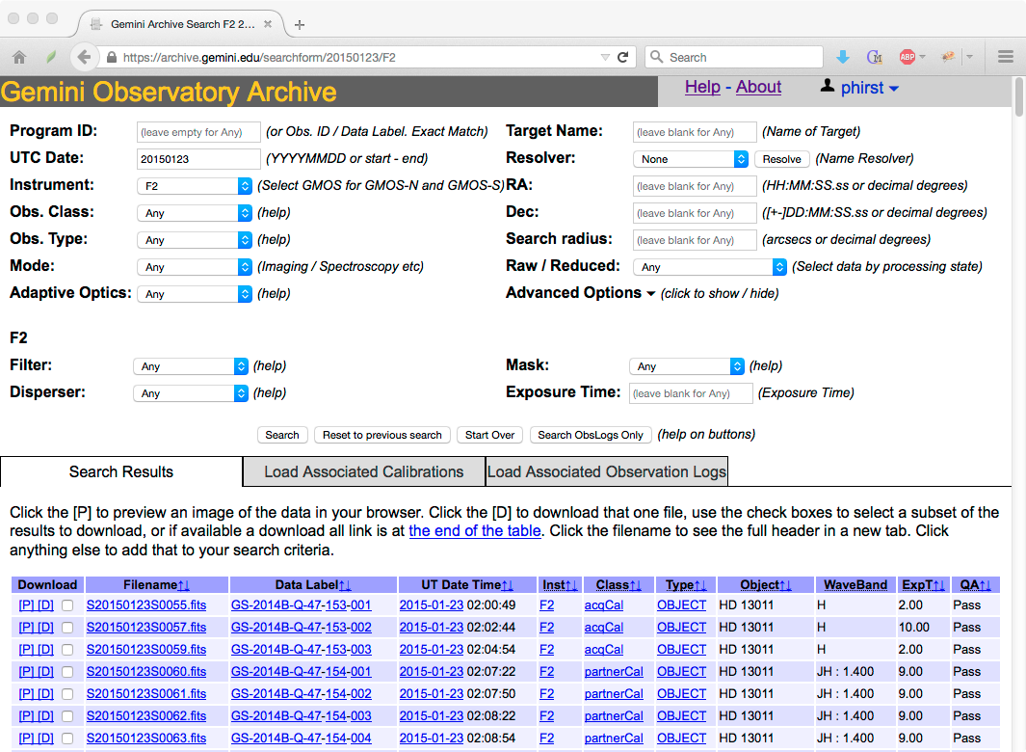
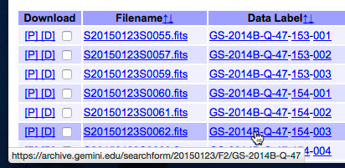

Slide 13
You can bookmark this, copy and paste it into your notes, Email or IM it to your collaborators, etc.
Going to the link is just the same as filling out the form and clicking the Search button.
Form Submit = Parse Form Fields -> Construct URL -> HTTP REDIRECT to that URL

Slide 14
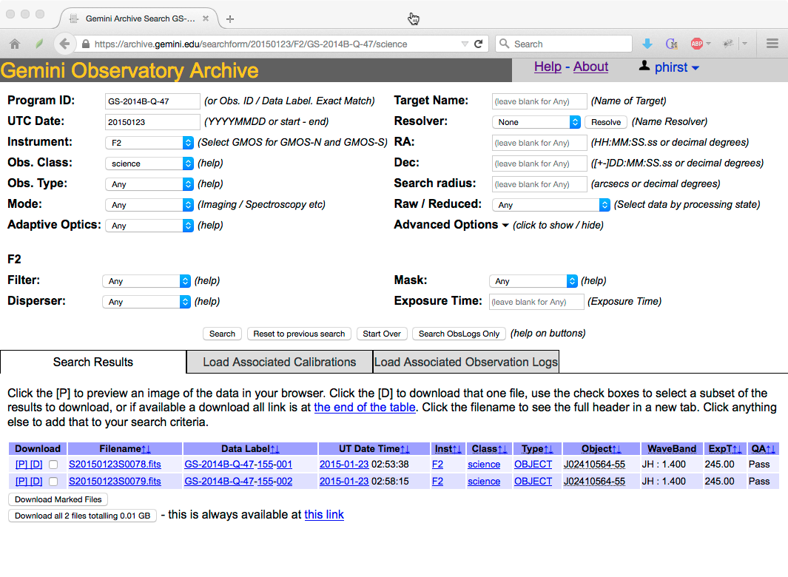
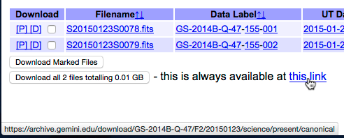
Notes:
Users love this - they can figure out their search using the search-form interactively, see how to compose the URL, then trivially switch to calling an API instead.

Slide 15
pyGOA API Examples
See https://archive.gemini.edu/help/api.html for basic documentation and examples.
Some example code and a python library for the boilerplate archive communication is at
https://github.com/bryanmiller/pygoa_gemini
or
pip install pygoa-gemini

Slide 16
jsonsummary
Provides a JSON equivalent of the results from the searchform interface (used by the web site).
Include ‘/canonical’ for information on the latest versions of files.
import pygoa.pygoa as pygoa
query = '/canonical/OBJECT/GMOS-N/20101231'
results = pygoa.goa_json(query, option='jsonsummary')

Slide 17
jsonfilelist
Provides basic information in JSON on the files that match a query.
import pygoa.pygoa as pygoa
query = '/canonical/GN-2010B-Q-22/GMOS-N/20101231'
results = pygoa.goa_json(query, option='jsonfilelist')
print(results[‘filename’])

Slide 18
Use goa_files to download files
Preview jpeg
filename = ‘N20101231S0338.fits’
file = pygoa.goa_file(filename, filedir=home + '/Downloads/', option='preview')
Individual FITS file
file = pygoa.goa_file(filename, filedir=home + '/Downloads/', option='file’)

Slide 19
Use goa_files to download files
TAR file of everything that matches a query
query = '/canonical/GN-2010B-Q-22/GMOS-N/20101231'
file = pygoa.goa_file(query, filedir=home + '/Downloads/', tarfile='gnQ22_20101231.tar', option='download')

Slide 20
calmgr
Returns XML of the results of the calibration associations
import xml.etree.cElementTree as ElementTree
xml = pygoa.goa_calmgr(query + '/photometric_standard')
results = ElementTree.fromstring(xml)
tag = results.tag[0:results.tag.find('}')+1]
for dataset in results.findall(tag+'dataset'):
for cal in dataset.findall(url+'calibration'):
print(cal.find(tag+'datalabel').text

Slide 21
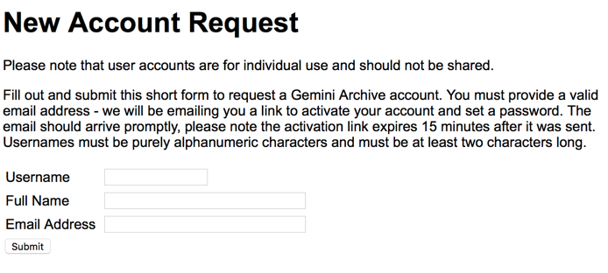
You must have an archive account in order to download proprietary data
https://archive.gemini.edu/request_account/

Slide 22
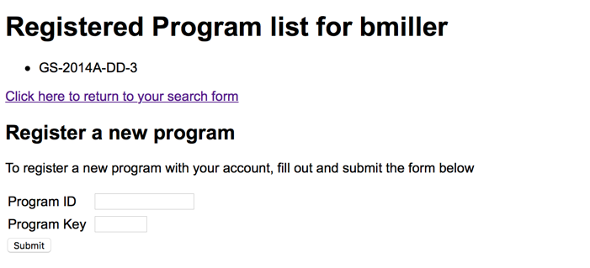
Then register the programs for which you have a “program key”
https://archive.gemini.edu/my_programs
The “program key” is sent to the PI when a program is created.

Slide 23
Finally, obtain a web cookie to authenticate using the APIs
Instructions are given at
https://github.com/bryanmiller/pygoa_gemini
Note, this cookie will change if you logout/login.

Slide 24
Then add the cookie to the requests
Individual FITS file
filename = ‘N20101231S0338.fits’
goa_auth = pygoa.get_goa_authority()
file = pygoa.goa_file(filename, filedir=home + '/Downloads/', option='file’, cookie=goa_auth)

Slide 25
Data Reduction in Transition
The Gemini IRAF package is being replaced with a pure python equivalent
Python imaging package to be released in late 2019
Spectroscopy reduction in Python ongoing
Automated processing is now a requirement (AEON/GEMMA)
New Gemini instruments (e.g. SCORPIO) come with reduction tools that work in our Python pipeline environment (DRAGONS).
See https://www.gemini.edu/node/10795

Slide 26
Archive Development Plans
The archive needs to be upgraded to support the distribution of reduced data from the DRAGONS pipeline.
Improve the user interface for reduced data products considering data provenance (eg. linking raw and reduced products and tracking the software version)
Provide for programmatic (e.g. TOMs) communication to enable automatic download of products.
Make authentication compatible with OCS Upgrades

Slide 27
TOM Toolkit Gemini Plugin Improvement Ideas
Add data download from the Gemini Observatory Archive.
Add option to run guide star search before observation request.
Display png of FoV with selected guide star in UI
Scrape instrument and ToO status web pages
Add non-sidereal support if the ODB URL API is updated.
Process Gemini data
Imaging can be automated in 2020+ using DRAGONS
Spectroscopy with the IRAF/pyraf package

Slide 28
How to get help/support
Gemini helpdesk:
https://www.gemini.edu/sciops/helpdesk/
Data Reduction Forum
http://drforum.gemini.edu
Email Bryan
bmiller@gemini.edu

